Slide 1
Unmanned Aircraft System Security Model Survey
Matthew Whitesides
Professor Bruce M. McMillin
CS6600: Formal Methods in Computer Security

Slide 2
Outline
Unmanned Aircraft System Overview
Security Model Scenario
ACM & System Overview
Rights Leakage Findings
HRU
T-G
Security Classification Solutions
Q&A

Slide 3
Unmanned Aircraft System Overview
Unmanned Aircraft Systems (UAS) are air vehicles and associated equipment that do not carry a human operator.
They are instead are remotely piloted or fly autonomously.
Generally within an organization, a UAS can encompass the whole system of an unmanned aerial vehicle (UAV), control stations, command operations, maintenance systems, etc.

Slide 4
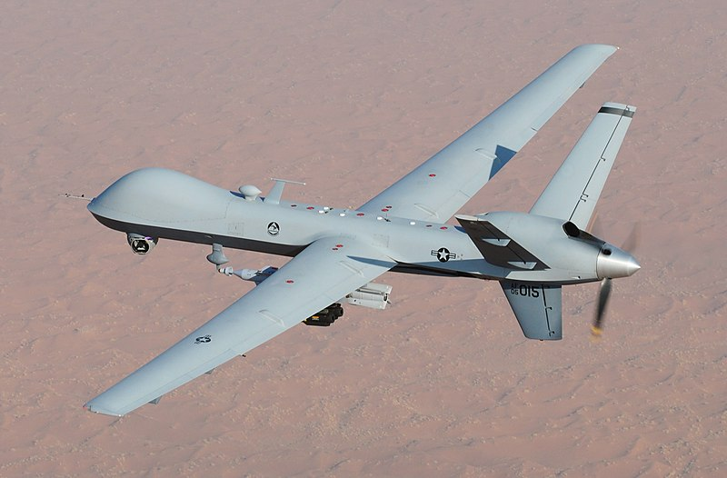
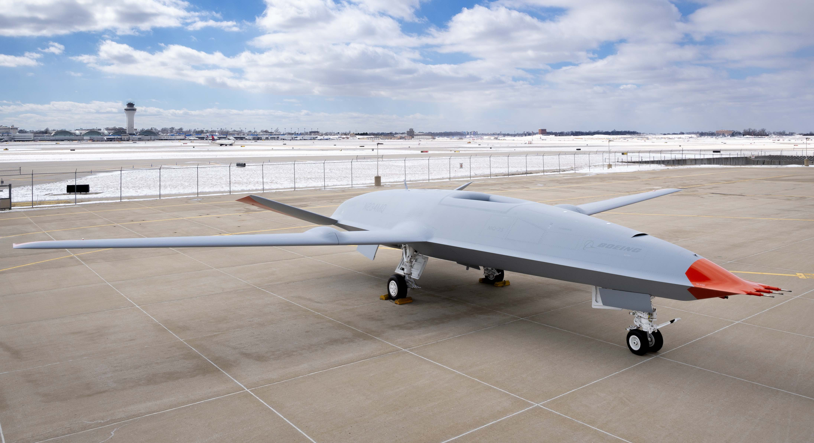
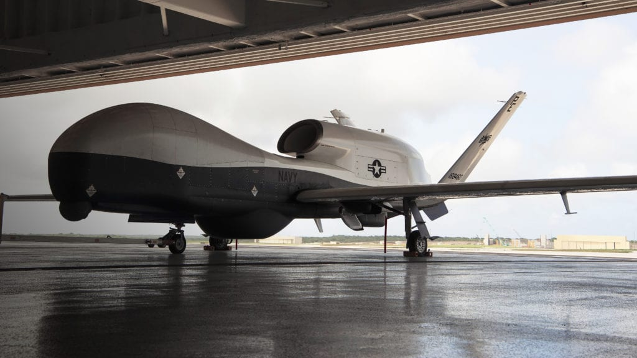
Unmanned Aircraft System Overview
Some examples of UAVs include:
General Atomics MQ-9 Reaper | Boeing MQ-25 Stingray | Northrop Grumman MQ-4C Triton

Slide 5
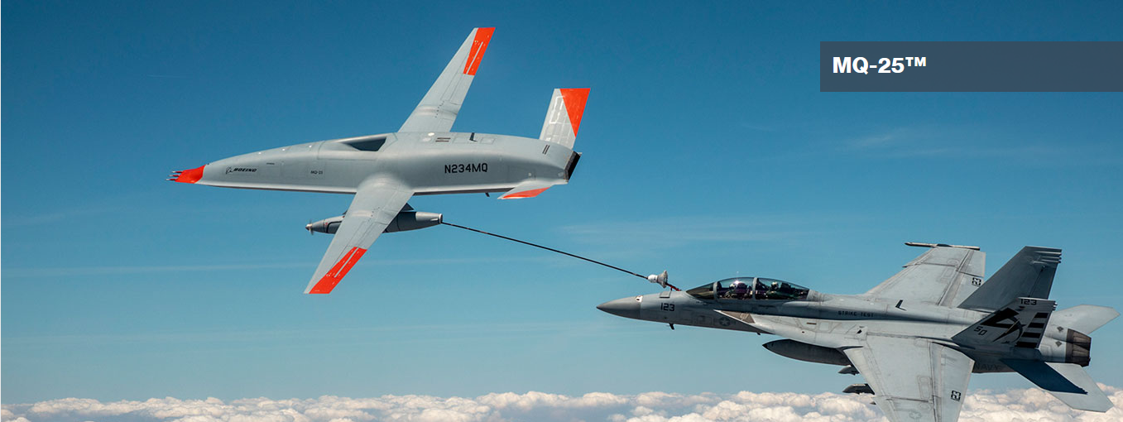
Unmanned Aircraft System Overview
For this security model simulation, we will take inspiration from an autonomous refueling aircraft.
These UAVs enable mid-flight refueling capabilities for larger aircraft to enable longer-range mission capabilities.
Boeing MQ-25
https://www.boeing.com/defense/mq25/

Slide 6
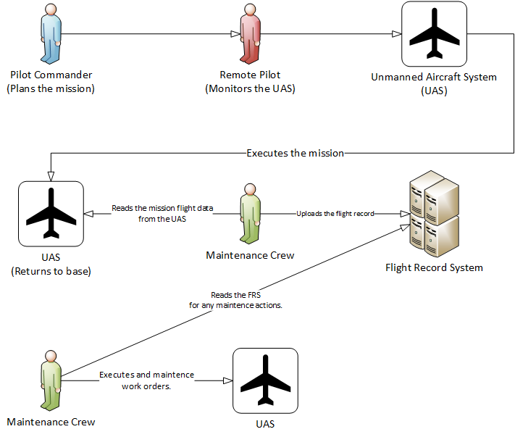
Security Model Scenario

